Slide 1

Vel Tech Rangarajan Dr. Sagunthala R&D Institute of Science and Technology
School of Computing
Department of Computer Science and Engineering
10211CS224 / FULL STACK APPLICATION DEVELOPMENT (JAVA)
END SEMESTER PROJECT REVIEW
Date: 06-05-2026
SMART CAMPUS EVENT AND REGISTRATION PORTAL
SDG 4 – Quality Education
Presented By:
P.Akshay Kumar– VTU25775 – 23UECS0979
Courses Handling Faculty:
Dr. Hafizur Rahaman -Assistant Professor

Slide 2
INTRODUCTION
1
2
Managing campus events manually leads to confusion and inefficiency.
Students struggle to find and register for events easily.
Organizers face issues in tracking bookings and attendees.
This project provides a centralized event booking platform.
Users can browse, register, and manage events online.
Admin can create, update, and monitor events.
Improves transparency and reduces manual errors.
Ensures a smooth and user-friendly experience.
3
4
5
6
7
8
9

Slide 3
PROBLEM STATEMENT
1
2
Existing systems are mostly manual or poorly organized.
No centralized platform for all campus events.
Difficulty in managing registrations and attendance.
High chances of data loss and errors.
Lack of real-time updates for users.
Time-consuming for both students and organizers.
Need for an automated and efficient system.
3
4
5
6
7
8
9

Slide 4
OBJECTIVE(S)
1
2
3
Develop an online event booking system for students.
Automate event management and registration process.
Provide real-time updates and easy access to event details.
4
5
6
7
8
9

Slide 5
PROPOSED SYSTEM
1
2
3
Web-based platform for event browsing and booking.
User authentication (login/register).
Event listing with details (date, venue, slots).
Online booking with confirmation.
Admin panel for event management.
Database to store users, events, bookings.
Notification/confirmation system.
Reduces manual effort and improves efficiency.
4
5
6
7
8
9

Slide 6
PROPOSED SYSTEM ARCHITECTURE
1
2
3
4
Input: User/Admin enters login details, selects events, and gives booking inputs.
Processing: Backend validates data, handles booking logic, and processes requests.
Database: Stores user data, event details, and booking records securely.
Output: Displays event information and booking confirmation to the user.
5
6
7
8
9

Slide 7
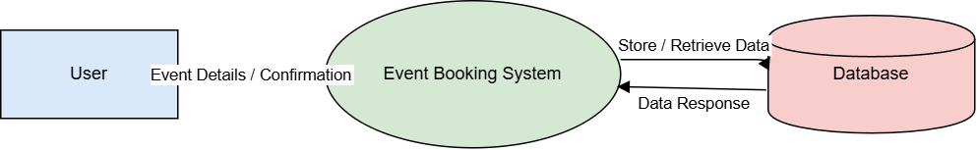
WORKFLOW
1
2
3
4
5
6
7
8
9

Slide 8
TECHNOLOGIES USED
1
Frontend: React.js, Tailwind CSS
Backend: Node.js / Java (Spring Boot if used)
Database: MySQL / MongoDB
API: REST APIs
Tools: VS Code, Git, Postman
Requirements: Browser, Internet connection
2
3
4
5
6
7
8
9

Slide 9
MODULE DESCRIPTION
Module 1: User Management
Registration, login, authentication
Module 2: Event Management
Create, update, delete events (Admin)
Module 3: Booking System
Users book events and get confirmation
Module 4: Database Management
Stores and retrieves all system data
Module 5: Notifications / Enhancements
Booking confirmation / alerts
1
2
3
4
5
6
7
8
9

Slide 10
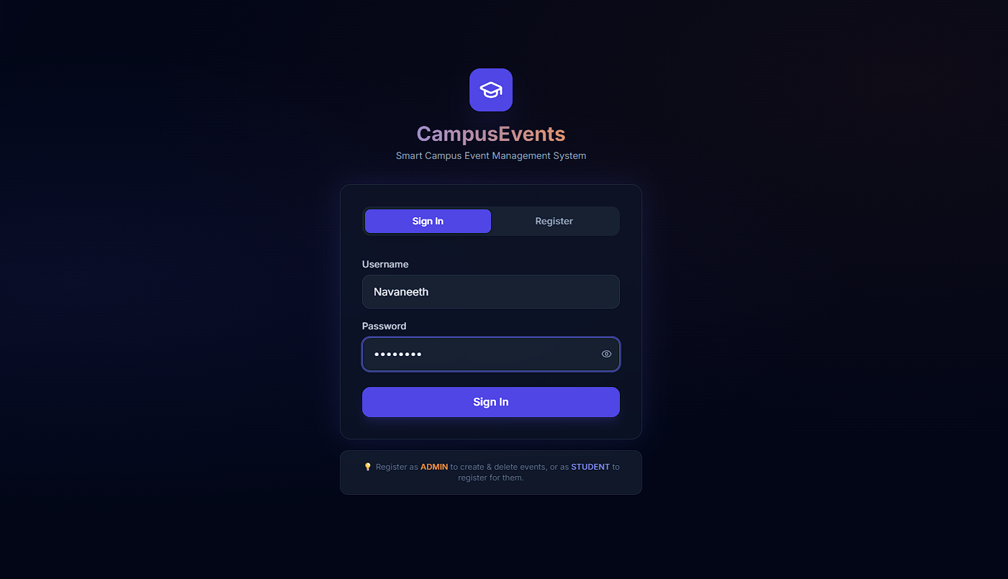
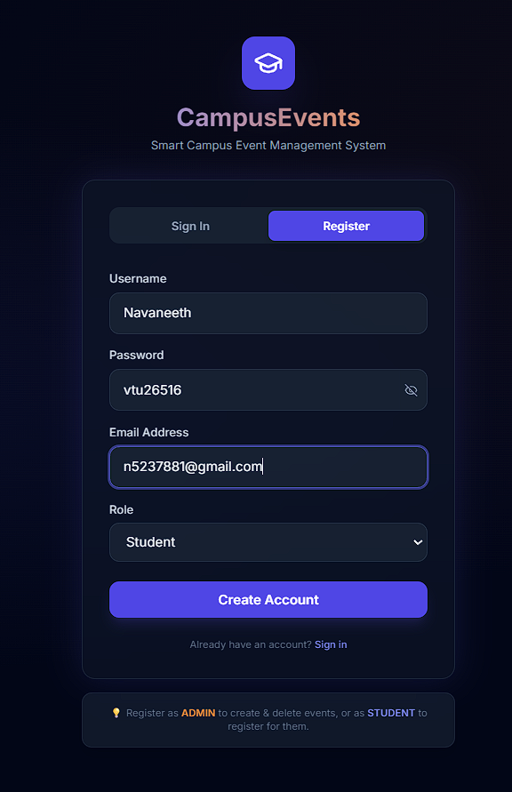
IMPLEMENTATION SCREENSHOTS
1
2
3
4
5
6
7
8
9

Slide 11
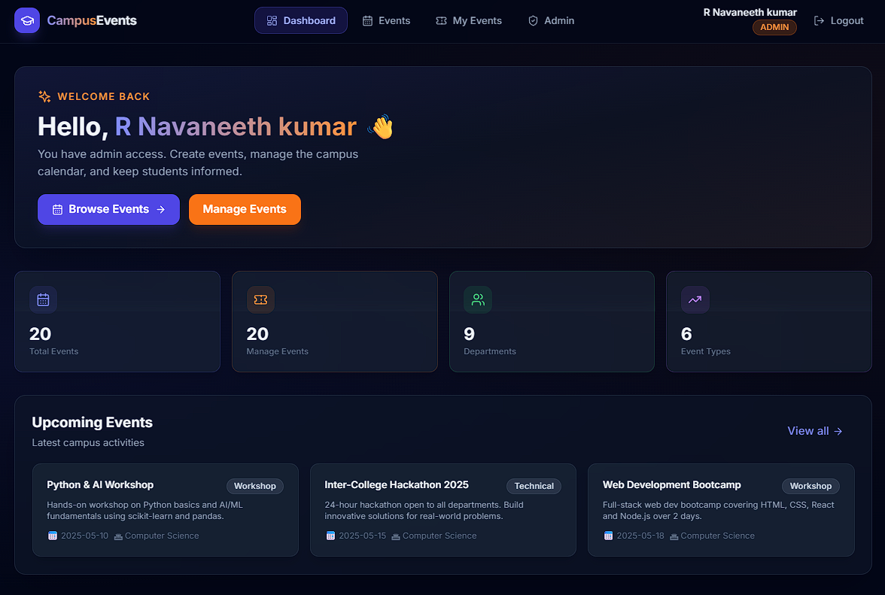
IMPLEMENTATION SCREENSHOTS
1
2
3
4
5
6
7
8(A)
The home page serves as the main entry point of the application.
It displays available events with details like name, date, and venue.
Users can browse events and navigate to login or booking options.
The interface is simple and designed for easy user interaction.
9

Slide 12
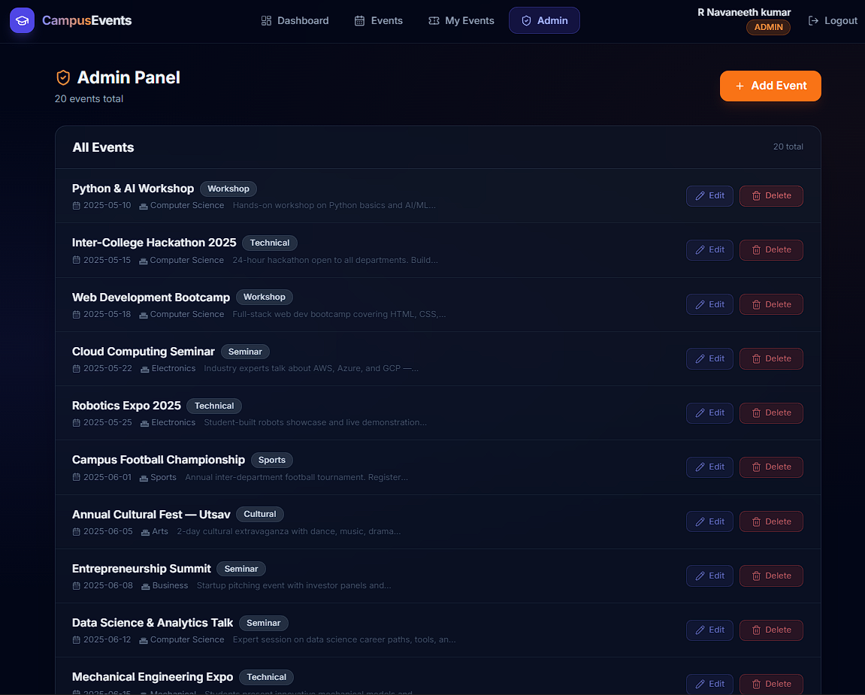
IMPLEMENTATION SCREENSHOTS
1
2
3
4
5
6
7
8(B)
Handles creation, updating, and deletion of events by the admin.
Displays event details such as name, date, venue, and availability.
Processes user actions like selecting and booking events.
Ensures validation and proper handling of event data.
9

Slide 13
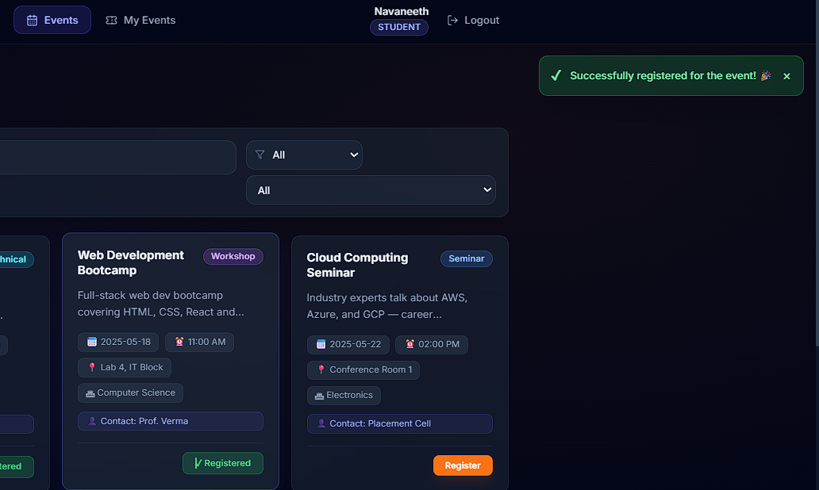
IMPLEMENTATION SCREENSHOTS
1
2
3
4
5
6
7
8(C)
This module sends notifications to users regarding booking confirmation and event updates.
It provides real-time alerts for successful registrations and important changes.
Notifications improve user engagement and keep users informed.
Enhances system usability by ensuring timely communication.
9

Slide 14
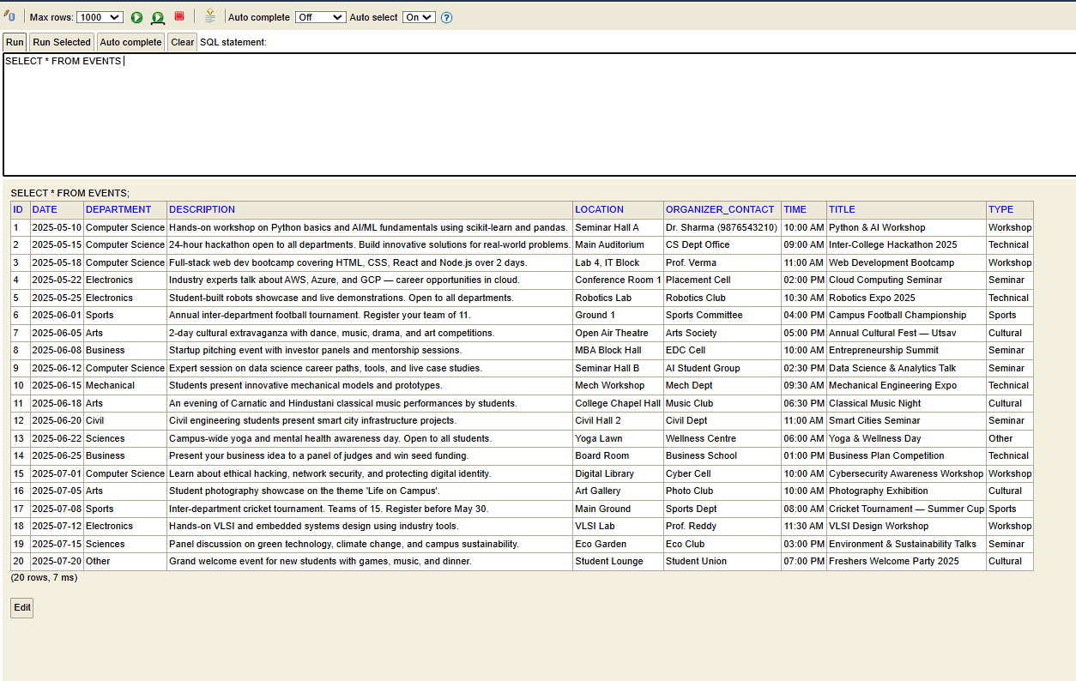
IMPLEMENTATION SCREENSHOTS
1
2
3
4
5
6
7
8(D)
9

Slide 15
ADVANTAGES & LIMITATIONS
1
ADVANTAGES :
Easy to use and accessible
Saves time and effort
Reduces manual errors
Centralized system
Real-time updates
LIMITATIONS :
Requires internet connection
Limited to campus-level usage
Security depends on implementation
2
3
4
5
6
7
8
9

Slide 16
Thank you

